Slide 1
Diabetes Health App
Promotion Presentation
Sim Yuh Fan
Sahendra Pang
Santi
Tan Xiang Feng
Zhang Zhewei
A0249251E
A0135877N
A0249294R
A0072452L
A0249258R
Notes:
AI-Powered, Do-It-Yourself (DIY), Diabetes Health App
The vision of this app is a digital health companion for everyone and everywhere.
As a MVP delivery the specific target is Diabetic Type 2.

Slide 2


Introduction
Diabetes is a worldwide health problem that have affected 400 million people worldwide.
Type 1 Diabetes
Type 2 Diabetes
Notes:
Diabetes is a worldwide health problem that have affected 400 million people worldwide.
There are two major types of diabetes:
Type 1 – often diagnosed in childhood.
Type 2 – largely caused by an unhealthy lifestyle and diet.

Slide 3


Notes:
While Singapore has one of the highest proportions of diabetes cases. The Ministry of Health believes that a third of the diabetes patient are unaware that they are ill.
This is exacerbated by barriers to health screenings such as not knowing where to get free screening, procrastination, and not seeing the point of going for screening without subsequent follow up or explanation from a healthcare provider, as noted by a nationwide study examining the knowledge, attitudes and practices pertaining to diabetes in Singapore
However, with early detection, one can manage and prevent diabetes. If left untreated, the situation may worsen, leading to long term complications such as blindness and lower limb amputation.

Slide 4


Problem Statement
High Proportion of Diabetes
Unaware that they are ill
Barriers to Health Screening
Notes:
While Singapore has one of the highest proportions of diabetes cases.
The Ministry of Health believes that a third of the diabetes patient are unaware that they are ill.
This is exacerbated by barriers to health screenings such as not knowing where to get free screening, procrastination, and not seeing the point of going for screening without subsequent follow up or explanation from a healthcare provider, as noted by a nationwide study examining the knowledge, attitudes and practices pertaining to diabetes in Singapore.
However, with early detection, one can manage and prevent diabetes. If left untreated, the situation may worsen, leading to long term complications such as blindness and lower limb amputation.

Slide 5
Solution
Phone App
Predicting Risk of Diabetes
Lifestyle Recommender
Detect Diabetic Retinopathy
Notes:
To combat diabetes and at the same time bringing convenience to everyone, we have developed a phone app with 3 features.
Feature 1: Predicting Risk of Diabetes
Individual will be able to predict their risk of having type 2 diabetes through some simple details such as height and weight.
Feature 2: Lifestyle Recommender
Individuals might be clueless in the effectiveness of their physical activities and dietary plan in reducing the risk of diabetes. Leveraging on our reasoning system, one will have a better idea if their dietary intake and physical activities enough to reduce risk of diabetes.
Feature 3: Detect Diabetic Retinopathy
Individual will be to detect Diabetic Retinopathy by simply uploading a photo of their retina to the app. By doing so, diabetic patient will be able to keep themselves “checked”, and reduce the frequent visit to the doctor.

Slide 6
DEMO!
Notes:
That’s our technical presentation.
Lets continue with product demonstration.

Slide 7
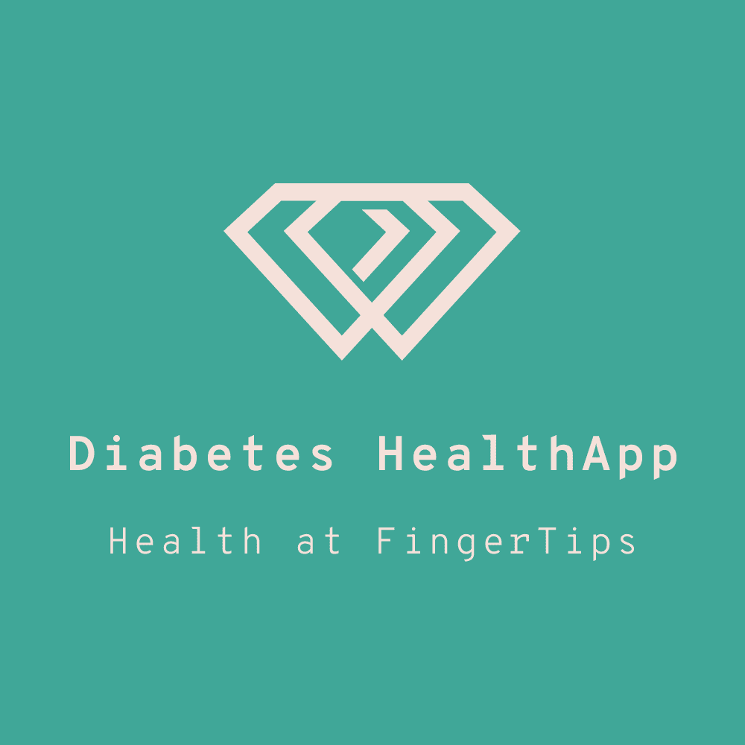
Notes:
Welcome to Diabetes Health App.
Health at fingertips

Slide 8

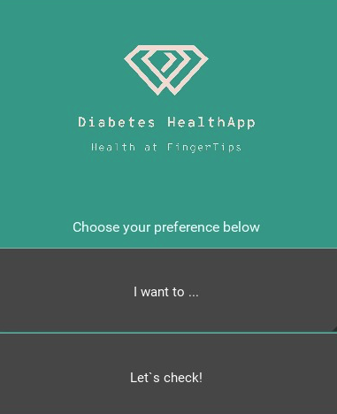
Notes:
I will be walking you through the app.
When starting the program, head over to the preference selection.

Slide 9
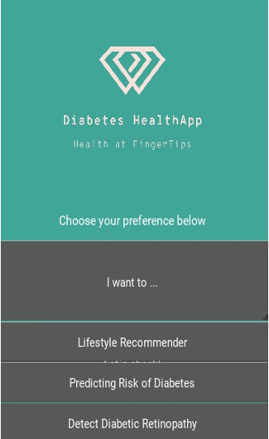
Notes:
Here you will find 3 selections.
Lifestyle recommender,
Predicting Risk of Diabetes and
Detect Diabetic Retinopathy.

Slide 10
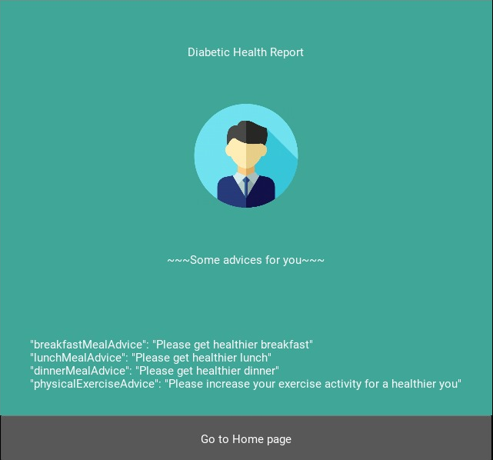
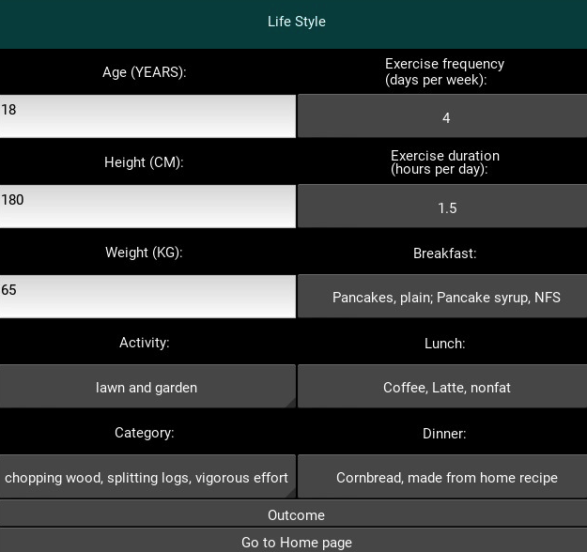
Notes:
Select Life style recommender.
New window will be opened.
The app will have few question for you.
Take your time to fill up all the answer to the question,
And tap the Outcome button once you complete the answer.
System will then generate the recommender report

Slide 11

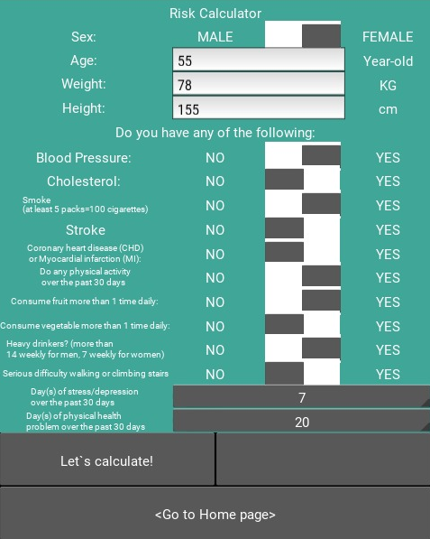
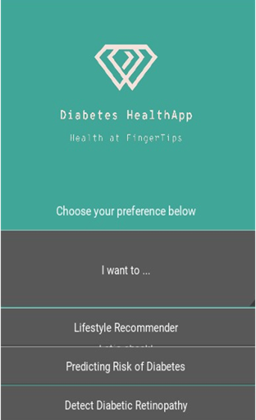
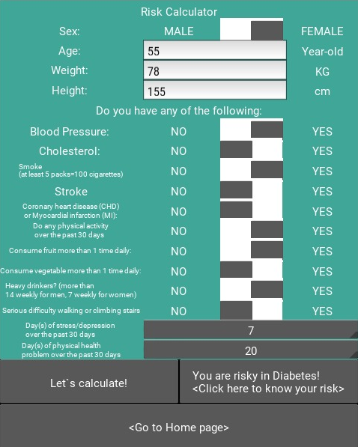
Notes:
Please review the recommender report.
Once done, head over back to Home page.
Tap on the predicting Risk of diabetes.
New windows with set of questions will be generated.
Please take your time to answer all the questions.
Click Lets Calculate and the system will generate the Risk level.

Slide 12
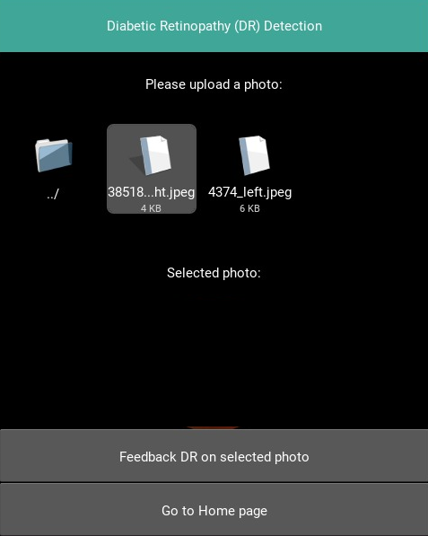
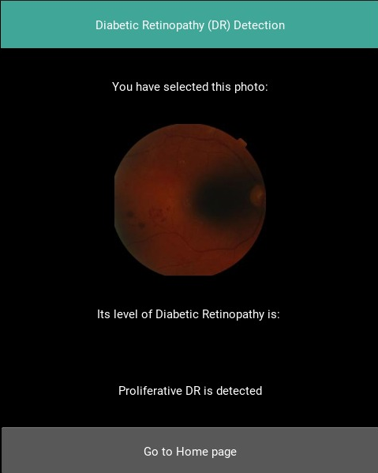
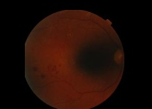
Notes:
Please head back to home page for diabetic Retinopathy check.
Tap on the Detect Diabetic Retinopathy option.
New screen will be open. Browse and select the image file that you want to check.

Slide 13

Product Value
Convenience
Zero Cost
Reduce Strain
in Healthcare
Notes:
This solution is able to tackle the above problem statement as it is:
Convenience – One can self-assess at their own convenience, or at the comfort of their home.
Zero Cost – For the low-income/ less privileged segment, they can get themselves regularly checked for free.
This greatly lower the barriers to health screenings. The high penetration rate of mobile devices in Singapore also allows this solution to be widely available to the entire population.
Furthermore, this reduces the strain on healthcare system as individuals can get themselves “checked”, prior to visiting the doctor if necessary.

Slide 14

Current Market
Automated with real time detection tool that can match human grading
Our solution is able to lower the barriers to screening, by bringing convenience to one’s doorstep, simply with the click of a phone app.
Notes:
Diabetes is a worldwide health issue, hence it is not surprising to see a number of products available in the market that provide medical diagnosis for diabetes.
While some might be fully automated and having the ability to do real-time detection that can match human grading, we individuals are still required to be physically present.
Our solution is able to lower the barriers to screening, by bringing convenience to one’s doorstep, simply with the click of a phone app.

Slide 15
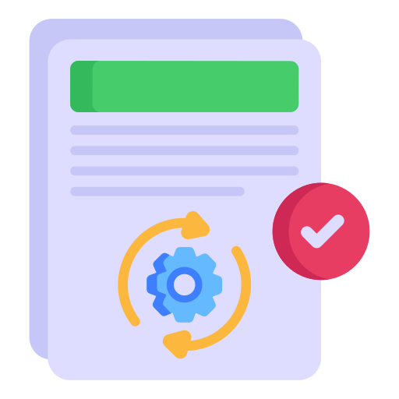
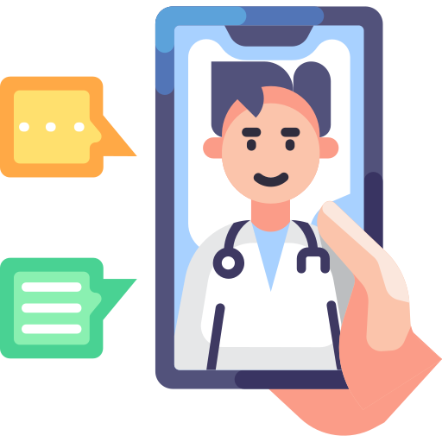
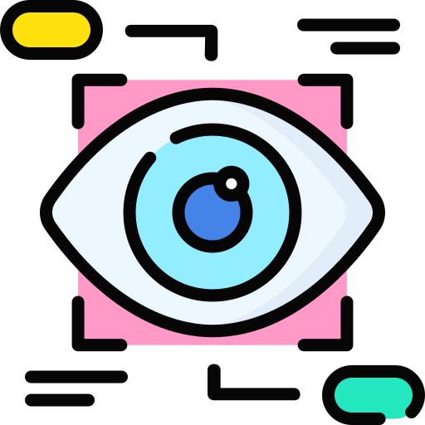
Future Development
Continuous model improvement with more use test
Connect user to Doctors
Grow other verticals to detect other health problems
Notes:
This phone app serves as an MVP and it will be improved upon in successive releases with more use experience.
This product has the potential to cover the full life cycle of diabetes and connect user to the doctor via the app
Build new verticals to detect health problems (i.e., Heart Diseases, Diabetes, Thyroid disorder, Cancer, and Multiple sclerosis) though our AI-enabled scanner.

Slide 16
Diabetes Health App
Notes:
With that, I’ll introduce you, the, Diabetes HealthApp.

Slide 17
THANKS!
Do you have any questions?
addyouremail@freepik.com
+91 620 421 838
yourcompany.com
Please keep this slide for attribution.

